Slide 1
International Relations Office
uib.cat

Slide 2
What steps do I need to take now?

Slide 3
Confirm
your courses
with your tutor
Tutor´s name and email in letter of acceptance
1

Slide 4
Fill in your learning agreement:

Slide 5
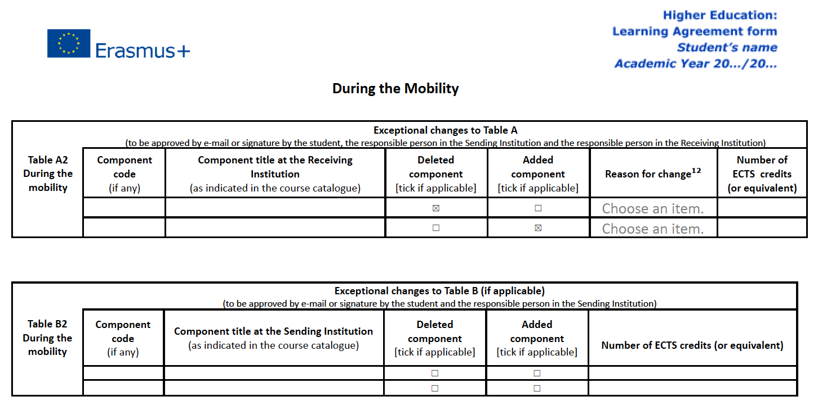
Don’t worry - you will have 3 weeks time in order to make changes and your academic Tutor will have to sign the changing form

Slide 6
Will I be able to enrol
on subjects out of my field of study?
Yes! However, at least 50%
of your subjects must be related to your area of study.

Slide 7
Before enrolling on subjects remember to check the timetables.

Slide 8
Where
do I enrol?
2

Slide 9
Come and visit us
before enrolling!
So that we can register your arrival.
Opening hours 10am-2pm
You will find us at the
Margalida Camps i Comas at the International Relations Office
Important note: you must set up
an appointment at the following link.

Slide 10
Enrol at
your faculty*
(enrolment will be
in-person)
Look for ‘Servicios Administrativos’
(Admin Services)
Office
* Students from the Faculty of Tourism must enroll at the Faculty of Economics, whereas Master students must enroll at the Centre for Postgraduate Studies.

Slide 11
If you chose programme code 9395 for Master’s degrees while filling in your application
you will have to enrol at the Centre for Postgraduate Studies.

Slide 12
At the time
of enrolment…
3

Slide 13
You must pay
the insurance fee (1,12€)
You can do this online* over your Student Portal
*You can also pay in cash at the bank office by downloading the tax receipt from your student´s portal in the Guillem Cifre de Colonya building.

Slide 14
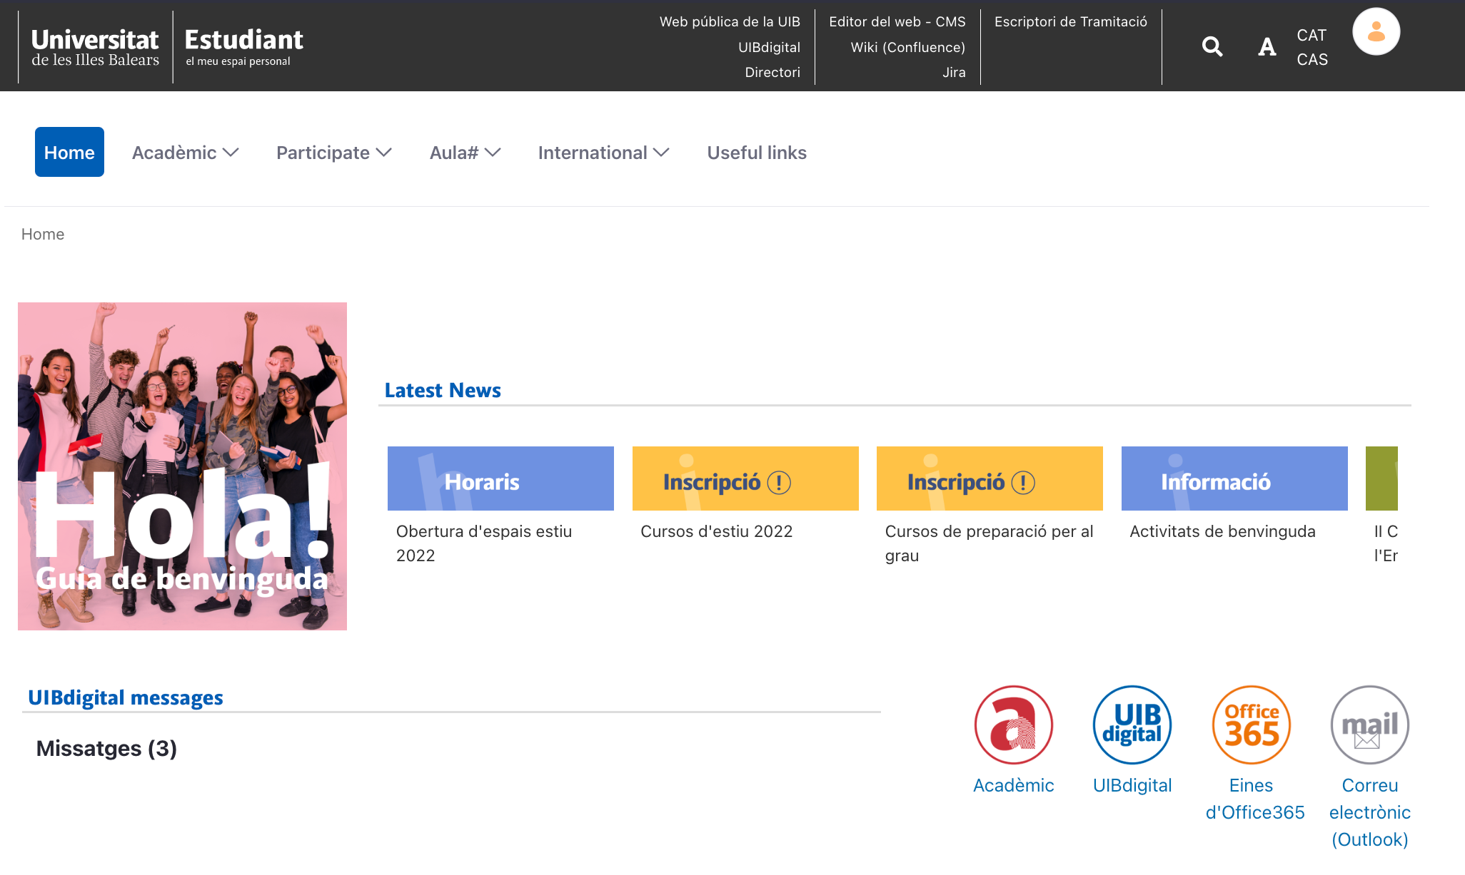
Pay the 1.12€ fee over Acadèmic, in the Student Portal:

Slide 15
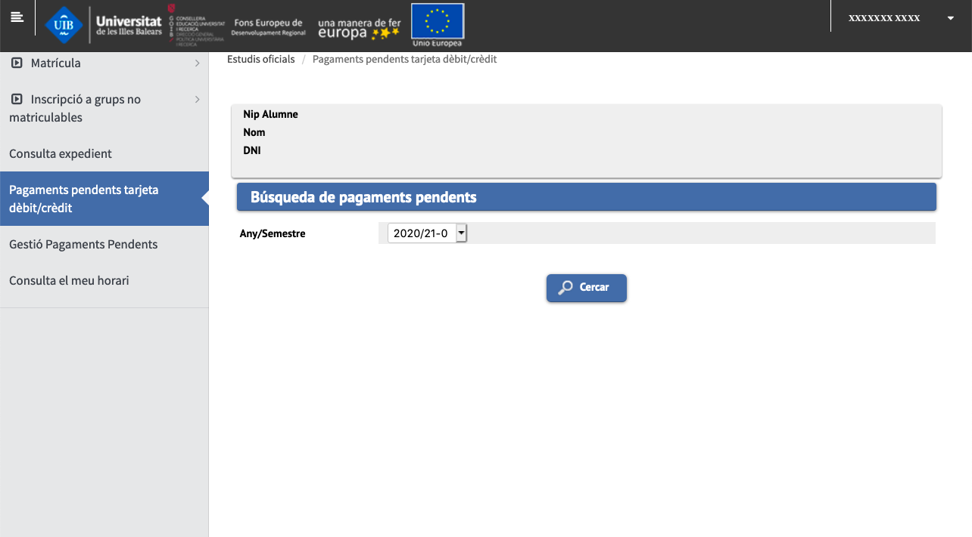
Once inside Acadèmic, go to the ‘Pagaments pendents…’ section:

Slide 16
After enroling:
Download the UIB App in order to get your student card:
a
b
Log in to it with
your credentials
and accept the
privacy policy
for the app.
Upload a profile
picture and fill in
your personal
details.

Slide 17
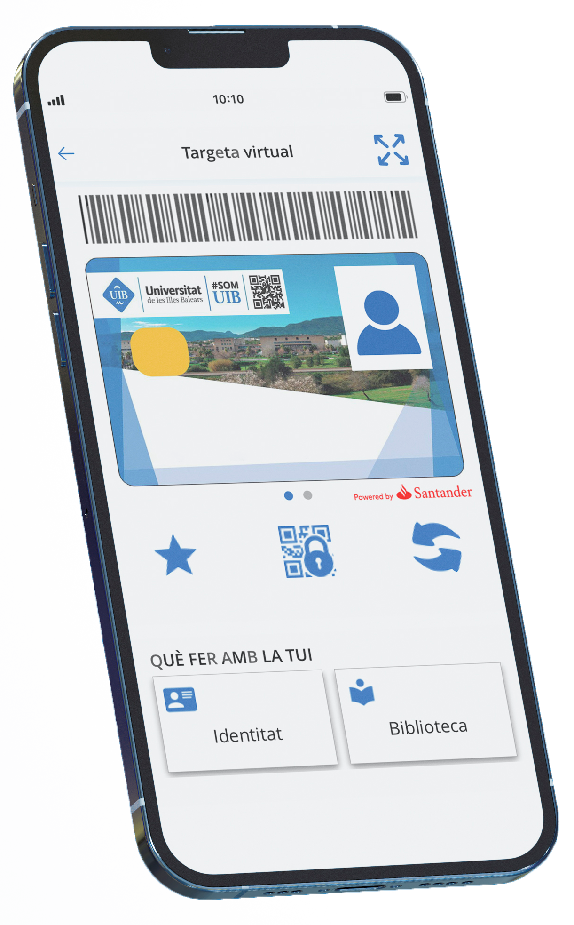
Once your
student card
is activated, you will
be able to start
enjoying all the
advantages
that come with it!

Slide 18
What can I do in UIBdigital?
4

Slide 19
Access UIBdigital through the Student Portal:

Slide 20
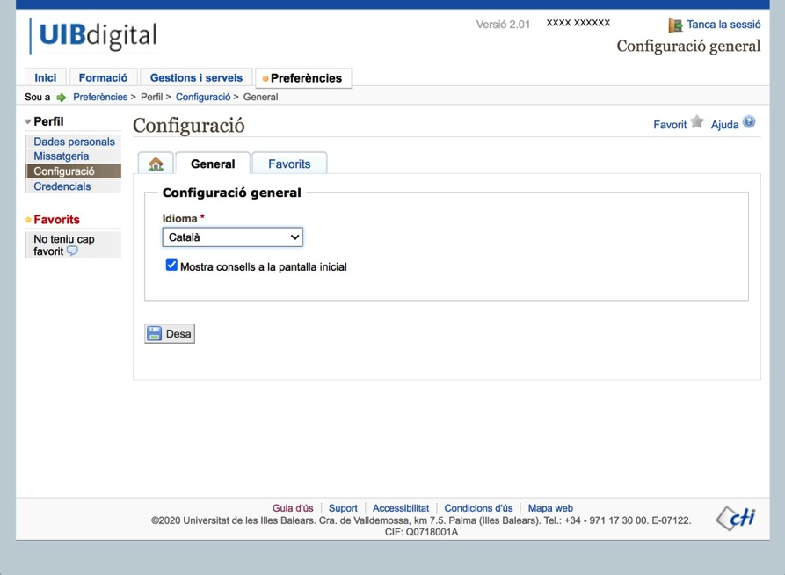
If you like, you can change the language to English:

Slide 21
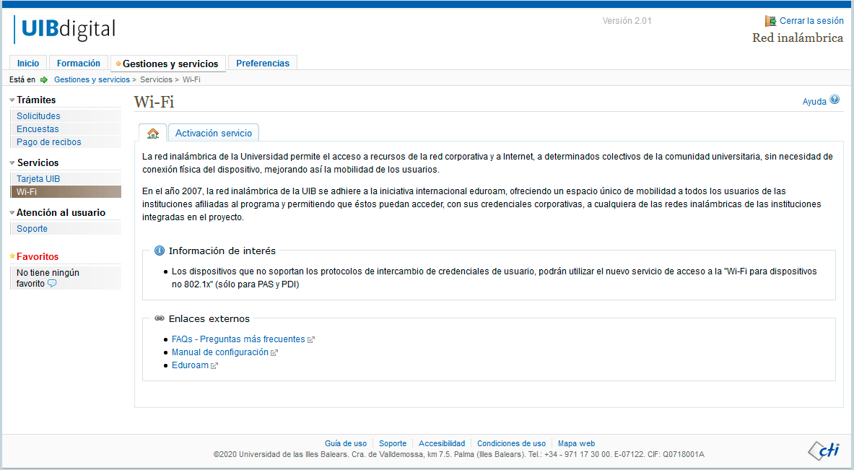
Activate the Wi-Fi service, or stay connected to Eduroam:

Slide 22
Set up your wifi on your phone, ipad,tablet and laptop…
Configuration
In order to configure the Wi-Fi service, you need to click the configuration link from your device and follow the steps shown. The system will provide the necessary installer for your operating system and the version of your device: • Wi-Fi Configuration For devices that are not supported by the link above, manual configuration is required by following the instructions below: • Android 4.2 or lower
Please follow the steps on your installer and login with your username@id.uib.eu and your password. Your device will automatically connect to the wifi service.

Slide 23
Don’t forget to activate your UIB e-mail account in UIBdigital!

Slide 24
How do I get to Campus
by bus and/or metro
for free?
5

Slide 25
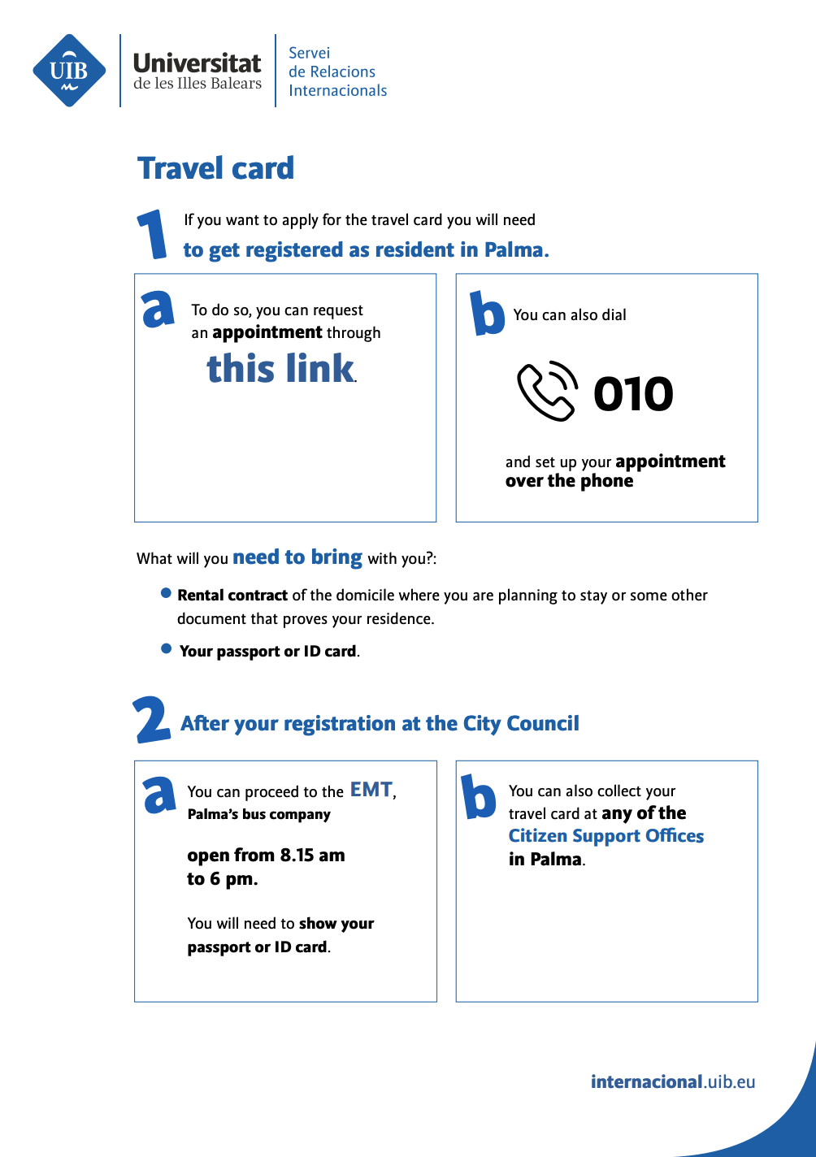
You can apply for your travel card for your bus trips!
There is a guide with instructions among the documents we provide.

Slide 26
!
You will have to get
registered at the
City Council
(rental contract and ID card or passport are required)

Slide 27
Apply for your
NIE number
6

Slide 28
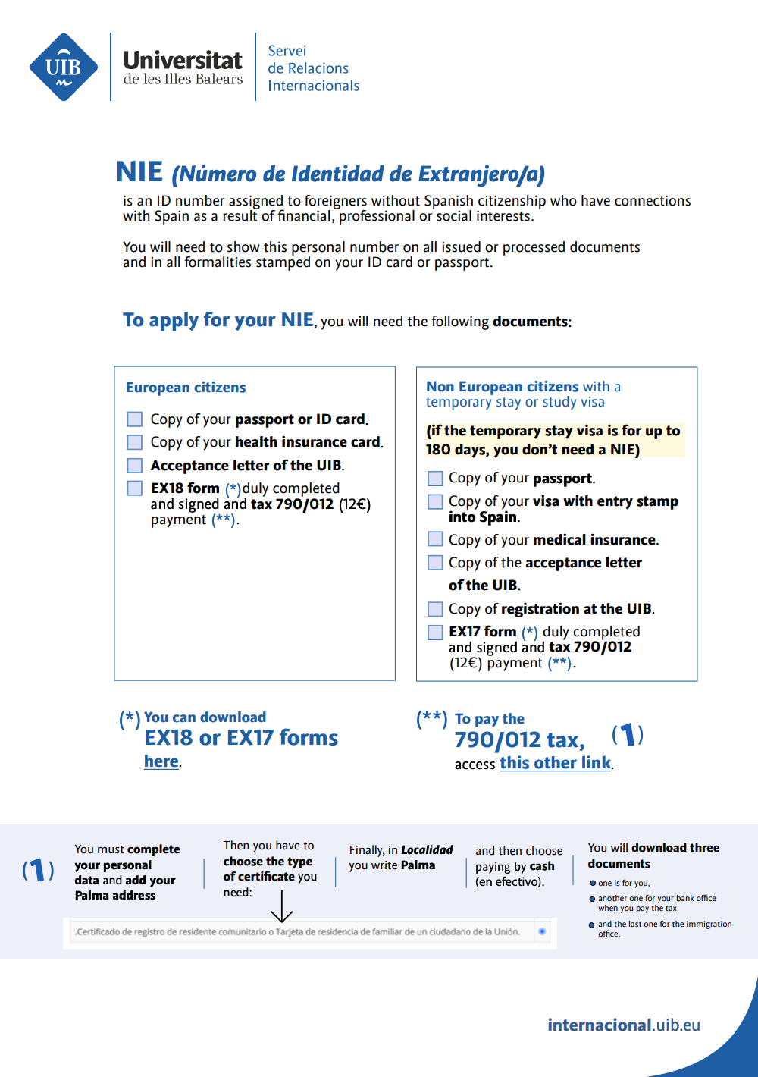
The NIE is a mandatory identity number for foreigners residing in Spain.
Don’t worry - we will hand you the information sheet shown here.

Slide 29
Do you want to be fluent in
Spanish and/or Catalan?
7

Slide 30
Join our language courses!
60 hours = 6 ECTS credits..
You get a special discount!
100€ per course
(standard price
is 400€)
Spanish course
Catalan course (25€)
Email address contact:
uibidiomes@fueib.org

Slide 31
Where can I download the documents
that I will need?
8

Slide 32
You can download them here.

Slide 33
International Relations Office
Opening hours:
Monday-Thursday,
10 am - 2pm
Visit us in Margalida Comes i Camps building
+34 971 17 27 20
971 25 96 57

